Slide 1
Machine Learning and Data Mining
宋笑影
Office：武钢楼1507
QQ：946983532
Tel：13163385332

Slide 2
课程考核
课程考核办法：
闭卷考试
总评成绩构成：
平时成绩 30%
考试成绩70%

Slide 3
推荐网址
加州大学公开课 ：机器学习与数据挖掘
Coursera ( Alexander Ihler）：
http://sli.ics.uci.edu/Classes/2016W-178
斯坦福大学公开课 ：机器学习课程
Coursera (Andrew Ng):
http://open.163.com/special/opencourse/machinelearning.html
https://www.coursera.org/learn/machine-learning

Slide 4
推荐教材
Machine Learning, T. Mitchell, 1997, McGraw Hill, New York (第一本机器学习专门性教材)
机器学习, 周志华, 清华大学出版社
机器学习与数据挖掘, 周志华, 2007，中国计算机学会通讯
Introduction to Machine Learning, E. Alpaydin, 2004, MIT Press, Cambridge, MA
Pattern Classification, R. O. Duda, 2001, John Wiley & Sons, New York
The Elements of Statistical Learning, T. Hastie, 2009, 2nd edition, Springer, New York
Pattern Recognition and Machine Learning, C. M. Bishop, Springer, New York (偏向于贝叶斯学习算法)
Understanding Machine Learning, S. Shalev-Shwartz，S. Ben-David, 2014,Cambridge University Press, Cambridge, UK. (侧重于理论介绍)
……

Slide 5
数学基础
线性代数
概率论
高等数学
……

Slide 6
编程软件
Matlab
Octave (free)
Python
Numpy, MatPlotLib, SciPy…
R
Used mainly in statistics
• C++
For performance, not prototyping
……

Slide 7
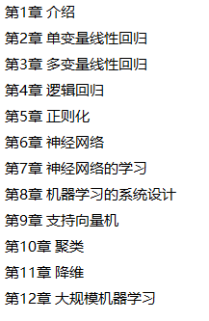
大纲目录

Slide 8

+
Machine Learning and Data Mining
Introduction

Slide 9
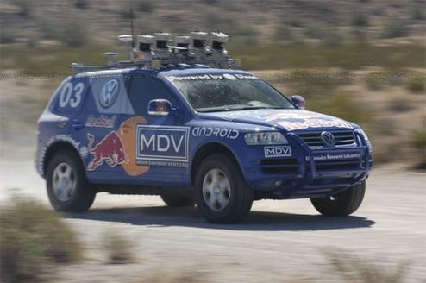
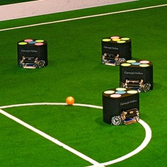

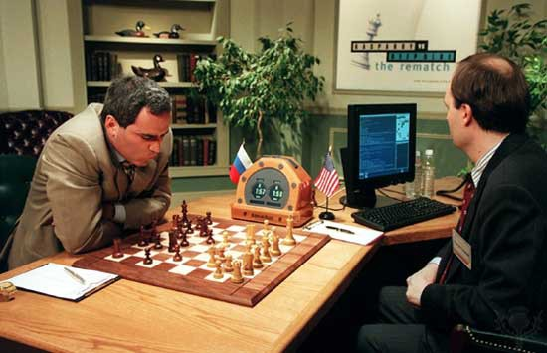
Artificial Intelligence (AI)
建立“智能系统”
系统的许多组成单元具有智能行为
Darpa GC (Stanley)
RoboCup
Chess (Deep Blue v. Kasparov)

Slide 10
学习方法关系图
深度学习
比如：MLPs等
表示学习
比如：自编码器
机器学习
比如：逻辑回归
人工智能
比如：专家系统
[1] Ian Goofellow etal. Deep Learning. MIT Press, 2016.

Slide 11
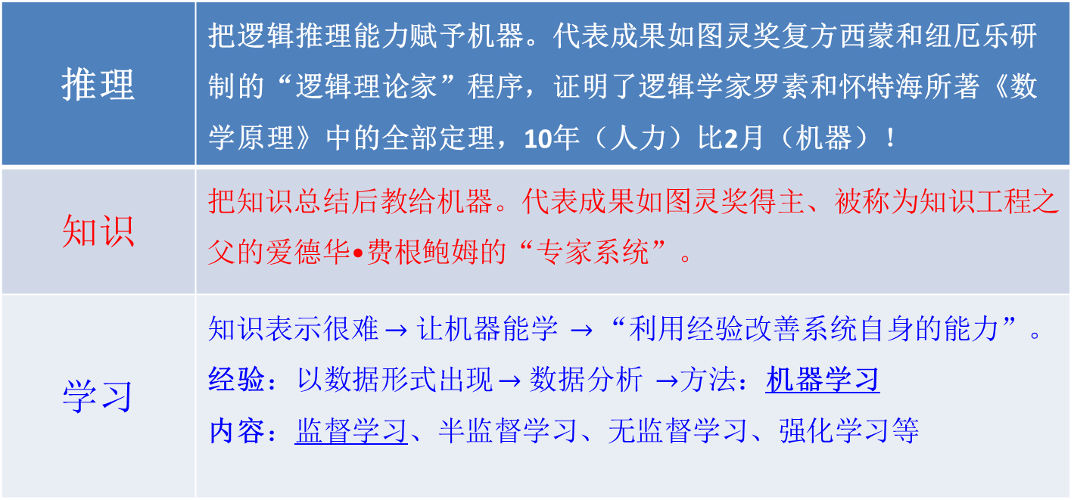
AI的发展历程：三个阶段
逻辑推理 $→$ 知识工程$→$ 机器学习
推理 | 把逻辑推理能力赋予机器。代表成果如图灵奖复方西蒙和纽厄乐研制的“逻辑理论家”程序，证明了逻辑学家罗素和怀特海所著《数学原理》中的全部定理，10年（人力）比2月（机器）！
知识 | 把知识总结后教给机器。代表成果如图灵奖得主、被称为知识工程之父的爱德华•费根鲍姆的“专家系统”。
学习 | 知识表示很难 $→$ 让机器能学 $→$“利用经验改善系统自身的能力”。 经验：以数据形式出现 $→$ 数据分析 $→$方法：机器学习 内容：监督学习、半监督学习、无监督学习、强化学习等

Slide 12
通俗定义：
任何通过数据训练的学习算法的相关研究都属于机器学习
经典ML算法：
K-线性回归（Linear Regression）
K-均值聚类方法（K-means）
主成分分析（Principal Component Analysis, PCA）
决策树（Decision Trees）和随机森林 （Random Forest）
支持向量机（Support Vector Machines）
人工神经网络（Artificial Neural Networks）

Slide 13
正式些的定义
利用经验改善系统自身的性能！
具体涉及：
学习是一个蕴含特定目的的知识获取过程，其内部表现为新知识的不断建立和修正，而外部则表现为性能改善。
经验（数据和常识），在此更多指的是数据，即从数据中总结规律用于将来的预测。
具体如何学习——视数据包含的信息相应学习。

Slide 14
学习系统
模型空间
（linear/nonlinear）
数据
（big/small data）
学习算法
学得模型
机器学习的主要内容：
研究在计算机上从数据中产生model的算法，
即“学习算法”（learning algorithm）。

Slide 15
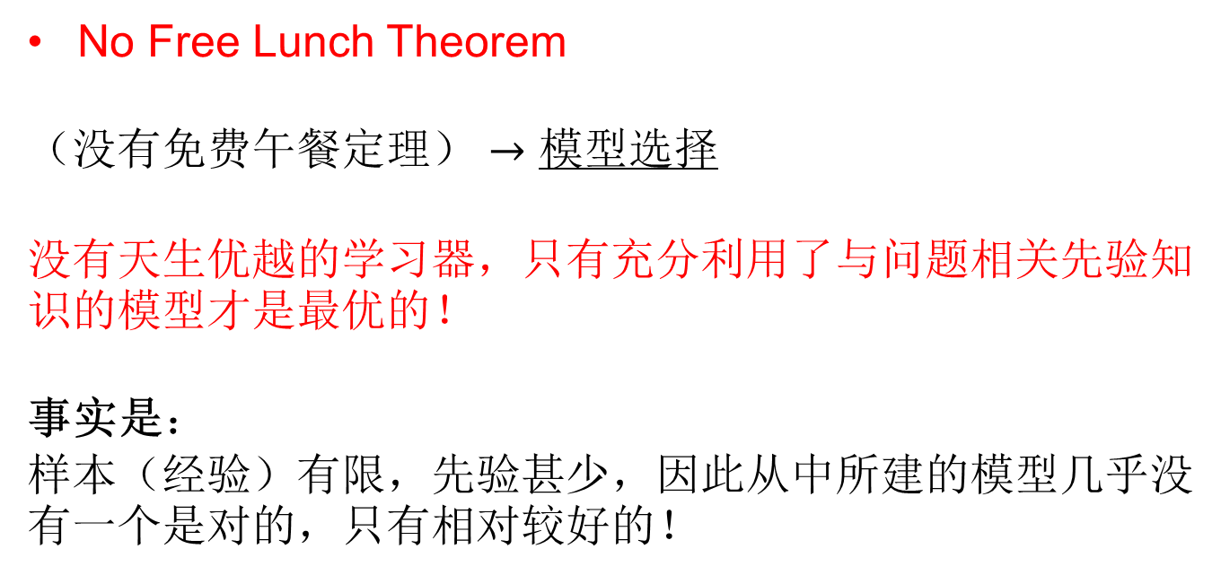
模型选择指导原则
No Free Lunch Theorem
（没有免费午餐定理） $→$ 模型选择
没有天生优越的学习器，只有充分利用了与问题相关先验知识的模型才是最优的！
事实是：
样本（经验）有限，先验甚少，因此从中所建的模型几乎没有一个是对的，只有相对较好的！

Slide 16
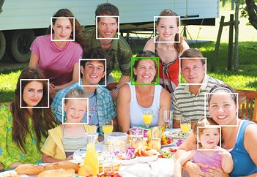
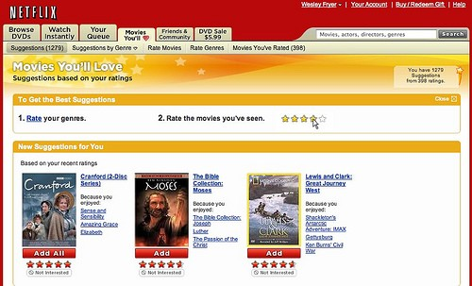
Machine learning (ML)
One (important) part of AI
Making predictions (or decisions)
Getting better with experience (data)
Problems whose solutions are “hard to describe”

Slide 17
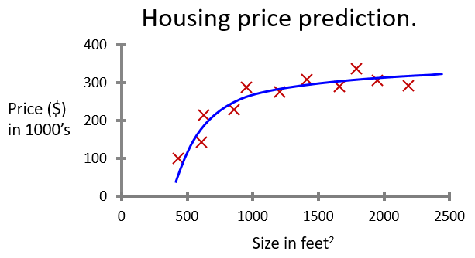
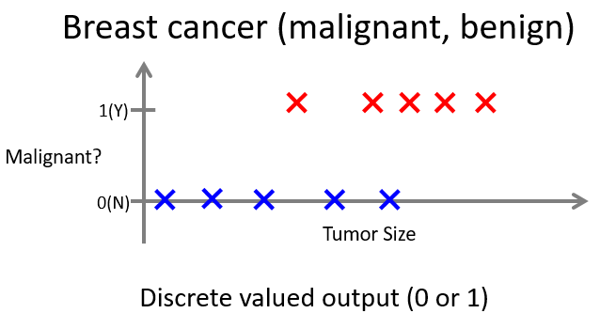
Types of prediction problems
Supervised learning
“Labeled” training data
Every example has a desired target value (a “best answer”)
Reward prediction being close to target
Classification: a discrete-valued prediction
Regression: a continuous-valued prediction

Slide 18
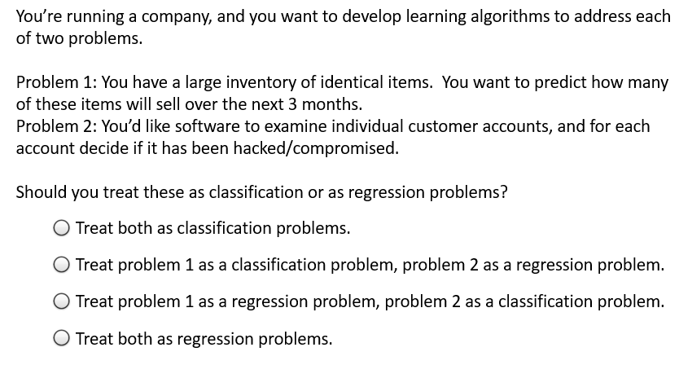

Slide 19
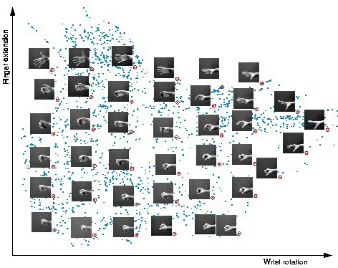

Types of prediction problems
Supervised learning
Unsupervised learning
No known target values
No targets = nothing to predict?
Reward “patterns” or “explaining features”
Often, data mining
The Color Purple
serious
Braveheart
Amadeus
Sense and Sensibility
Lethal Weapon
“Chick flicks”?
Ocean’s 11
The Lion King
Dumb and Dumber
The Princess Diaries
Independence Day
escapist

Slide 20
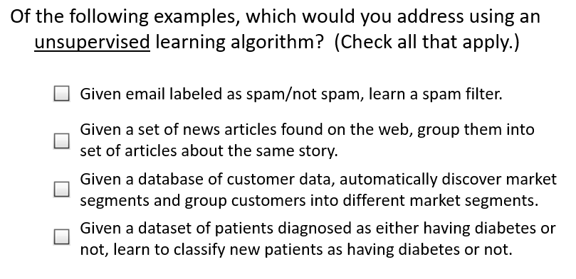

Slide 21
Types of prediction problems
Supervised learning
Unsupervised learning
Semi-supervised learning
Similar to supervised
some data have unknown target values
E.g. medical data
Lots of patient data, few known outcomes
E.g. image tagging
Lots of images on Flikr, but only some of them tagged

Slide 22

Types of prediction problems
Supervised learning
Unsupervised learning
Semi-supervised learning
Reinforcement learning
Strategy: perform an action in a state
No answers, just “better” or “worse”
AlphaGo

Slide 23
Summary
What is machine learning?
Data science
How do we learn from data to improve performance?
Types of machine learning
Supervised learning
Unsupervised learning
Semi-supervised learning
Reinforcement learning

Slide 24
+
Machine Learning and Data Mining
Introduction:
Data Exploration & Visualization

Slide 25
Data exploration
Machine learning is a data science
Look at the data; get a “feel” for what might work
What types of data do we have?
Binary values? (spam; gender; …)
Categories? (home state; labels; …)
Integer values? (1..5 stars; age brackets; …)
(nearly) real values? (pixel intensity; prices; …)
Are there missing data?
“Shape” of the data? Outliers?

Slide 26



Representing data
Example: Fisher’s “Iris” data
http://en.wikipedia.org/wiki/Iris_flower_data_set
Three different types of iris
“Class”, y
Four “features”, x₁,…,x₄
Length & width of sepals & petals
150 examples (data points)

Slide 27
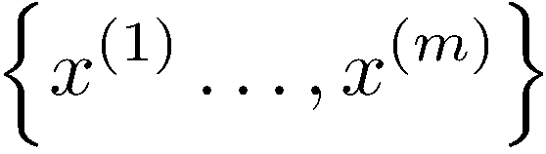
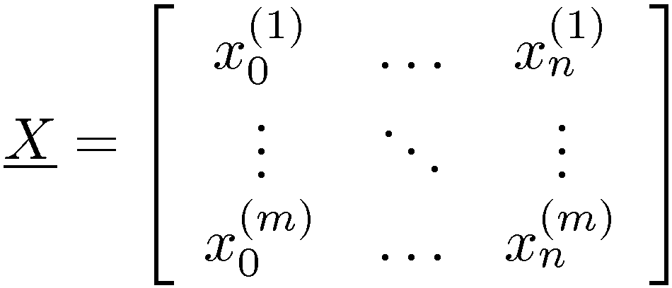
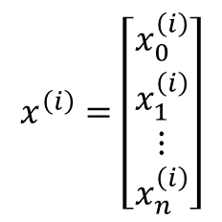
Representing the data
Have m observations (data points)
Each observation is a vector consisting of n features
Often, represent this as a “data matrix”
$$x^{\left(i\right)}=\left[\begin{matrix}x_{0}^{\left(i\right)} \\ x_{1}^{\left(i\right)} \\ ⋮ \\ x_{n}^{\left(i\right)}\end{matrix}\right]$$
import numpy as np # import numpy
iris = np.genfromtxt("data/iris.txt",delimiter=None)
X = iris[:,0:3]
Y = iris[:,4] print X.shape
(150, 4)
# load data and split into features, targets
# 150 data points; 4 features each

Slide 28
Basic statistics
Look at basic information about features
Average value? (mean, median, etc.)
“Spread”? (standard deviation, etc.)
Maximum / Minimum values?
print np.mean(X, axis=0)
[ 5.8433 3.0573 3.7580
# compute mean of each feature 1.1993 ]
#compute standard deviation of each feature 0.7622 ]
# largest value per feature
2.5236 ]
# smallest value per feature 0.0536 ]
print np.std(X, axis=0)
[ 0.8281 0.4359 1.7653
print np.max(X, axis=0)
[ 7.9411 4.3632 6.8606
print np.min(X, axis=0)
[ 4.2985 1.9708 1.0331

Slide 29
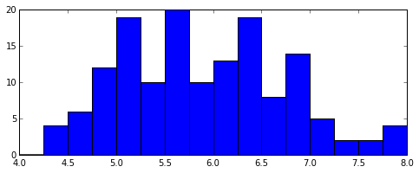
Histograms
Count the data falling in each of K bins
“Summarize” data as a length-K vector of counts (& plot)
Value of K determines “summarization”; depends on # of data
K too big: every data point falls in its own bin; just “memorizes”
K too small: all data in one or two bins; oversimplifies
% Histograms in MatPlotLib import matplotlib.pyplot as plt X1 = X[:,0]
Bins = np.linspace(4,8,17) plt.hist( X1, bins=Bins )
# extract first feature
# use explicit bin locations
# generate the plot

Slide 30
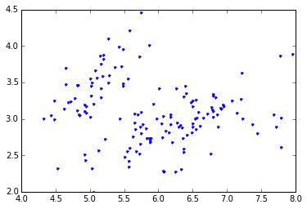


Scatterplots
Illustrate the relationship between two features
% Plotting in MatPlotLib
plt.plot(X[:,0], X[:,1], ’b.’); % plot data points as blue dots

Slide 31
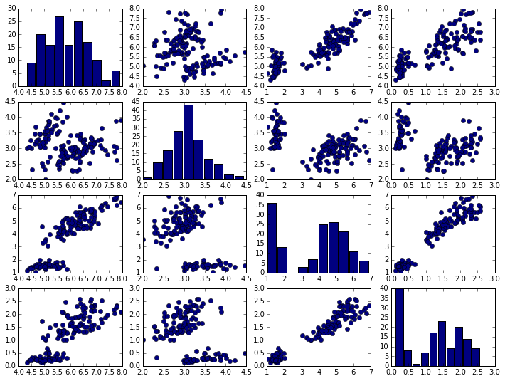




Scatterplots
For more than two features we can use a pair plot:

Slide 32
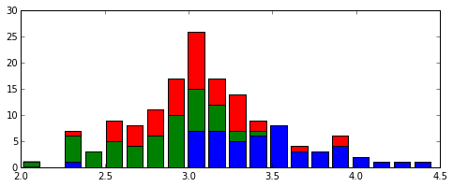
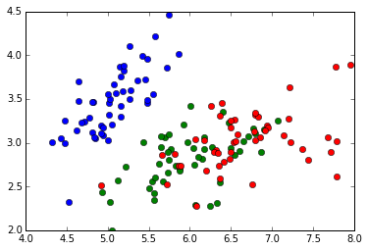
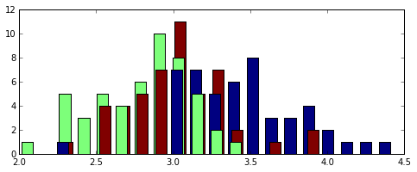
Supervised learning and targets
Supervised learning: predict target values
For discrete targets, often visualize with color
plt.hist( [X[Y==c,1] for c in np.unique(Y)] , bins=20, histtype='barstacked’)
colors = ['b','g','r']
for c in np.unique(Y):
plt.plot( X[Y==c,0], X[Y==c,1], 'o', color=colors[int(c)] )
ml.histy(X[:,1], Y, bins=20)

Slide 33
Summary
First step: get a feel for the data
Basic statistics
Histograms
Scatterplots & Pair Plots
Using color for discrete targets

Slide 34
+
Machine Learning and Data Mining
Introduction:
Supervised Learning

Slide 35
How does machine learning work?
“Meta-programming”
Predict – apply rules to examples
Score – get feedback on performance
Learn – change predictor to do better
Learning algorithm
Change µ
Improve performance
Program (“Learner”)
Characterized by some “parameters” µ
Procedure (using µ)
that outputs a prediction
Training data (examples)
Features
Feedback / Target values
Score performance (“cost function”)

Slide 36
Supervised learning
Notation
Features x
Targets y
Predictions ŷ
Parameters µ
Learning algorithm
Change µ
Improve performance
Program (“Learner”)
Characterized by some “parameters” µ
Procedure (using µ)
that outputs a prediction
Training data (examples)
Features
Feedback / Target values
Score performance (“cost function”)

Slide 37
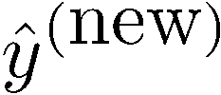
Regression; Scatter plots
40
_{y}(new) _{=?}
Target y
20
_{x}(new)
Feature x
0
0
10
20
Suggests a relationship between x and y
Prediction: new x, what is y?

Slide 38
Nearest neighbor regression
40
_{y}(new) _{=?}
Target y
20
_{x}(new)
Feature x
0
0
10
20
Find training datum x^{(i)} closest to x^{(new)}
Predict y^{(i)}

Slide 39
Nearest neighbor regression
“Predictor”:
Given new features:
Find nearest example Return its value
40
Target y
20
0
0
10
20
Feature x
Defines a function f(x) implicitly
“Form” is piecewise constant

Slide 40

Linear regression
“Predictor”:
Evaluate line:
40
Target y
return r
20
0
0
10
20
Feature x
Define form of function f(x) explicitly
Find a good f(x) within that family

Slide 41


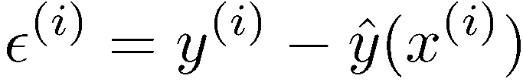

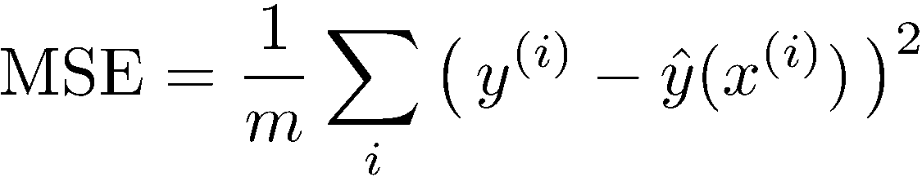
Measuring error
Error or “residual”
Observation Prediction
0
0
20

Slide 42
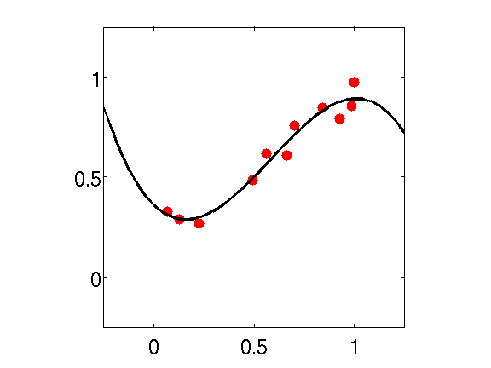
Regression vs. Classification
Regression
Classification
y
y
“flatten”
x
x
Features x
Real-valued target y
Features x Discrete class c
(usually 0/1 or +1/-1 ) Predict discrete function ŷ(x)
x
Predict continuous function ŷ(x)

Slide 43
Classification
?
X₂ !
X₁ !

Slide 44
Classification
All points where we decide 1
Decision Boundary
X₂ !
?
All points where we decide -1
X₁ !

Slide 45
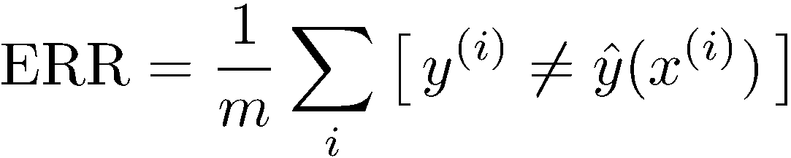
Measuring error
All points where we decide 1
Decision Boundary
X₂ !
All points where we decide -1
X₁ !

Slide 46
Summary
Supervised learning
Training data: features x, targets y
Regression
(x,y) scatterplots; predictor outputs f(x)
Mean squared error
Classification
(x,x) scatterplots
Decision boundaries, colors & symbols
Empirical error rate

Slide 47
+
Machine Learning and Data Mining
Introduction:
Overfitting & complexity

Slide 48
Overfitting and complexity
Y
X

Slide 49
Overfitting and complexity
Simple model: Y= aX + b + e
Y
X

Slide 50
Overfitting and complexity
Y = high-order polynomial in X
(complex model)
Y
X

Slide 51
Overfitting and complexity
Simple model: Y= aX + b + e
Y
X

Slide 52
Overfitting and complexity
Y
X

Slide 53
How Overfitting affects Prediction
Predictive Error
Error on Test Data
Error on Training Data
Model Complexity
Ideal Range
for Model Complexity
Underfitting
Overfitting

Slide 54
Competitions
Training data
Used to build your model(s)
Validation data
Used to assess, select among, or combine models
Personal validation; leaderboard; …
Test data
Used to estimate “real world” performance

Slide 55
Summary
What is machine learning?
Types of machine learning
How machine learning works
Supervised learning
Training data: features x, targets y
Regression
(x,y) scatterplots; predictor outputs f(x)
Classification
(x,x) scatterplots
Decision boundaries, colors & symbols
Complexity
Training vs test error
Under- & over-fitting

Slide 56
重点
机器学习方法主要包括4种类型（监督学习、半监督学习、无监督学习、强化学习）
监督学习与无监督学习的区别
线性回归与逻辑回归的区别
注意：逻辑回归是一种分类算法，不是回归算法

Slide 57
领域内顶级的学术会议与期刊
机器学习领域：
国际机器学习会议（ICML）、国际神经信息处理系统会议（NIPS）、国际学习理论会议（COLT）、欧洲机器学习会议（ECML）、亚洲机器学习会议（ACML）
Journal of Machine Learning Research、Machine Learing
人工智能领域：
IJCAI、AAAI
Artificial Intelligence、Journal of Artificial Intelligence Research
数据挖掘领域：
KDD、ICDM
ACM Transactions on Knowledge Discovery from data、Data Mining and Knowledge Discovery

Slide 58
领域内顶级的学术会议与期刊
计算机视觉与模式识别领域：
ECCV, ICCV ,CVPR
IEEE Transactions on Pattern Analysis and Machine Intelligence
神经网络领域：
Neural Computation、 IEEE Transactions on Neural Networks and Learning Systems
国内机器学习会议：
中国机器学习大会（CCML）、“机器学习及其应用”研讨会（MLA）
…………

